Slide 1
Intel Unnati Industrial Training 2025
Project Title : Design and Implementation of an Automated Sorting System Using Mechatronics Principles
Presented By : (Batch 5)
23951A6644 - B.Dhanush
23951A6654 - D.Gehana Sai
23951A6655 - D.Gopichand
23951A6656 - P.Hari Gopichand
Department - CSE(AI&ML)
Date - 05-04-2025

Slide 2
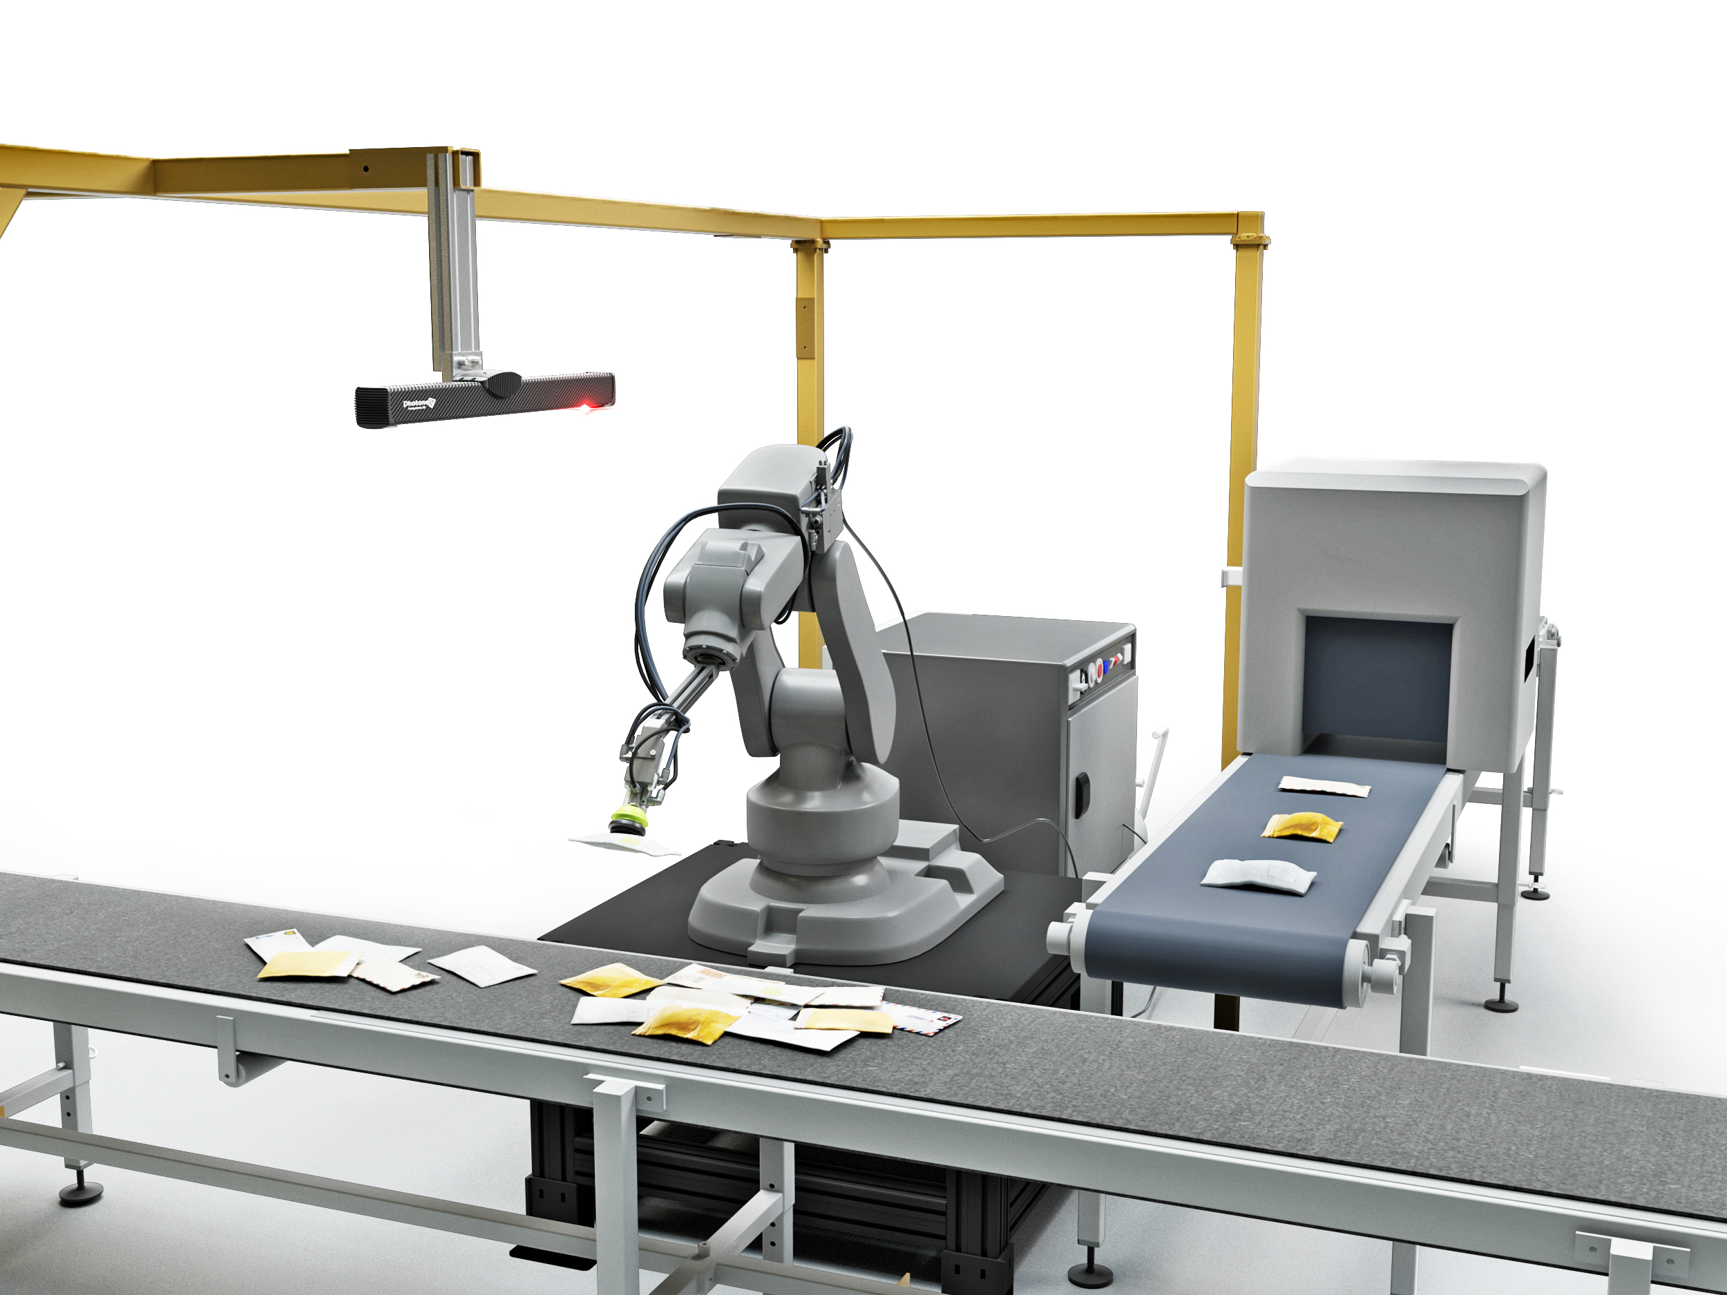
Introduction to Automated Sorting Systems
Automated sorting systems are essential in modern manufacturing and logistics.
They improve efficiency by reducing manual labor and minimizing errors.
This presentation outlines the design and implementation of an automated sorting system using mechatronics principles.
Notes:
Image source: https://equinoxmhe.com

Slide 3
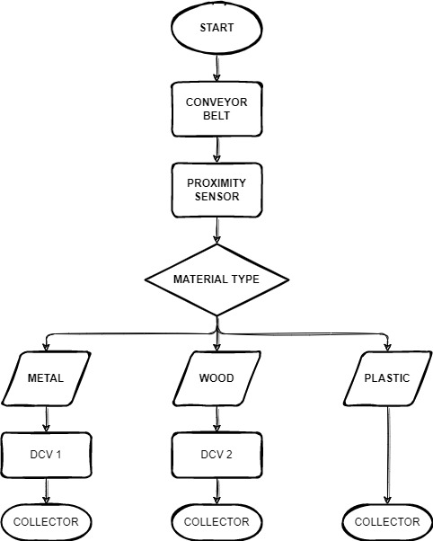
Objectives of the Project
The primary objective is to develop a system that sorts items based on predefined criteria.
We aim to increase sorting speed and accuracy compared to manual processes.
Another goal is to ensure the system is flexible for different types of items.
Notes:
Image source: https://thedigitalprojectmanager.b-cdn.net

Slide 4
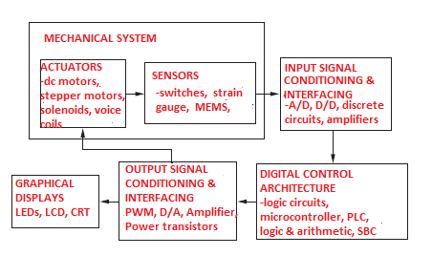
Overview of Mechatronics Principles
Mechatronics integrates mechanical engineering, electronics, computer science, and control engineering.
It allows for the creation of intelligent systems that can perform complex tasks autonomously.
Understanding mechatronics is crucial for designing effective sorting systems.
Notes:
Image source: https://thumbs.dreamstime.com

Slide 5
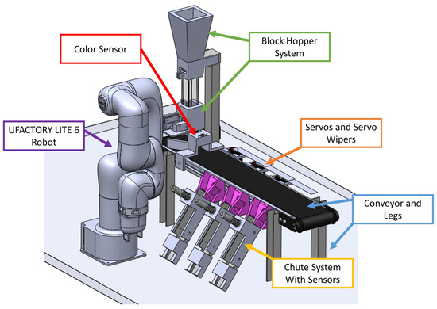
Components of the Automated Sorting System
The main components include sensors, actuators, and control units.
Sensors detect item characteristics like size, weight, and shape.
Actuators are responsible for moving items to the appropriate sorting bins.
Notes:
Image source: https://esortconveyor.com

Slide 6
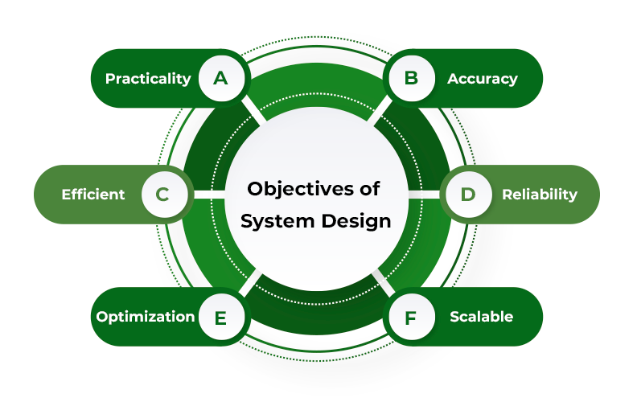
System Design Specifications
The system must accommodate various item sizes and weights.
It should operate at a minimum sorting speed of 200 items per hour.
The design must allow easy integration with existing warehouse management systems.
Notes:
Image source: https://media.geeksforgeeks.org

Slide 7
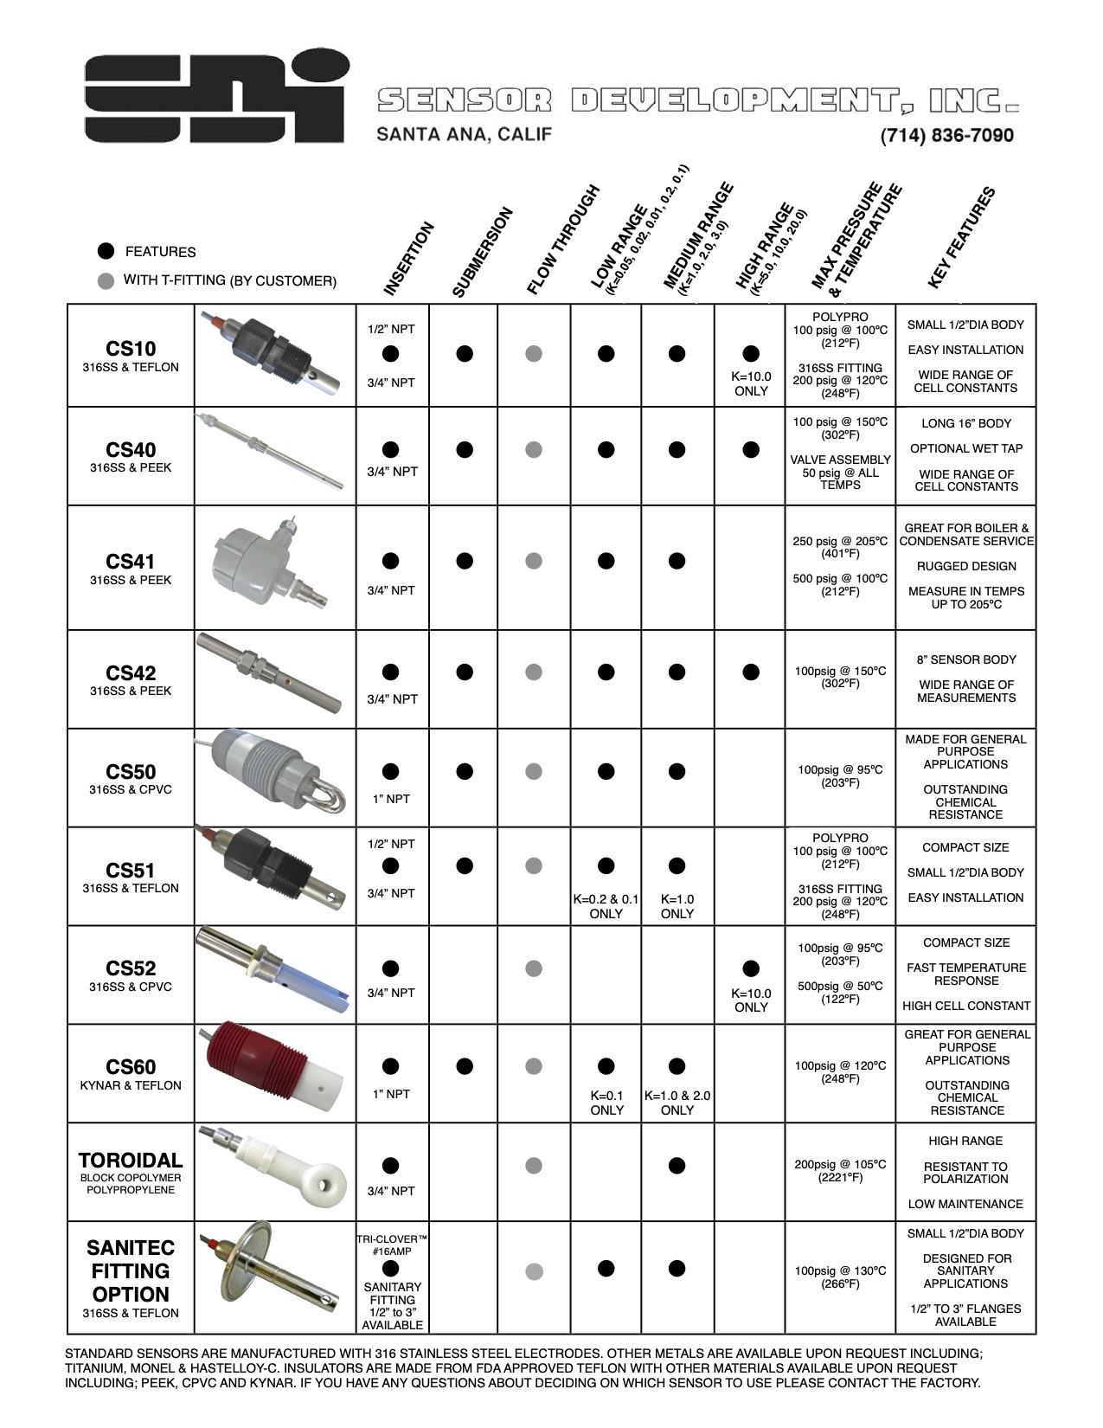
Sensor Selection and Configuration
Selection of sensors is critical for accurate item detection.
Common sensors used include infrared, ultrasonic, and camera-based systems.
Each sensor type has its advantages, depending on the sorting requirements.
Notes:
Image source: https://www.sensordev.com

Slide 8
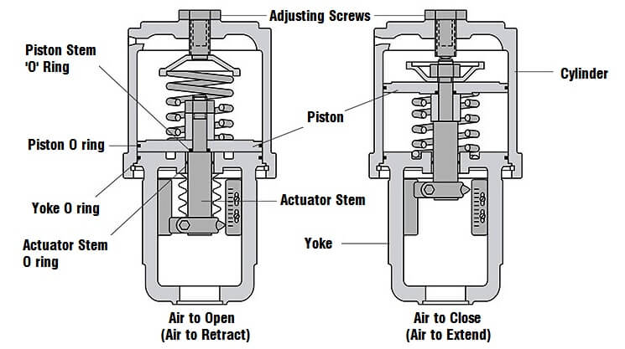
Actuation Mechanisms
Actuators can be pneumatic, hydraulic, or electric based on the application.
The choice of actuation mechanism affects the speed and efficiency of sorting.
Electric actuators are often preferred for their precision and ease of control.
Notes:
Image source: https://instrumentationtools.com

Slide 9
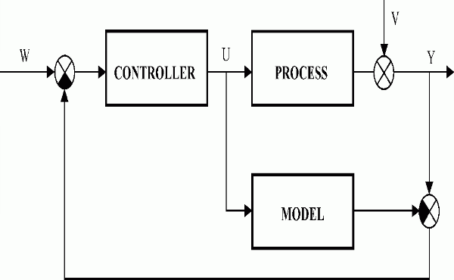
Control System Design
A robust control system is needed to coordinate the operation of sensors and actuators.
Programmable Logic Controllers (PLCs) are commonly used for industrial applications.
The control system should also include feedback loops for real-time adjustments.
Notes:
Image source: https://www.dpscontrol.sk

Slide 10
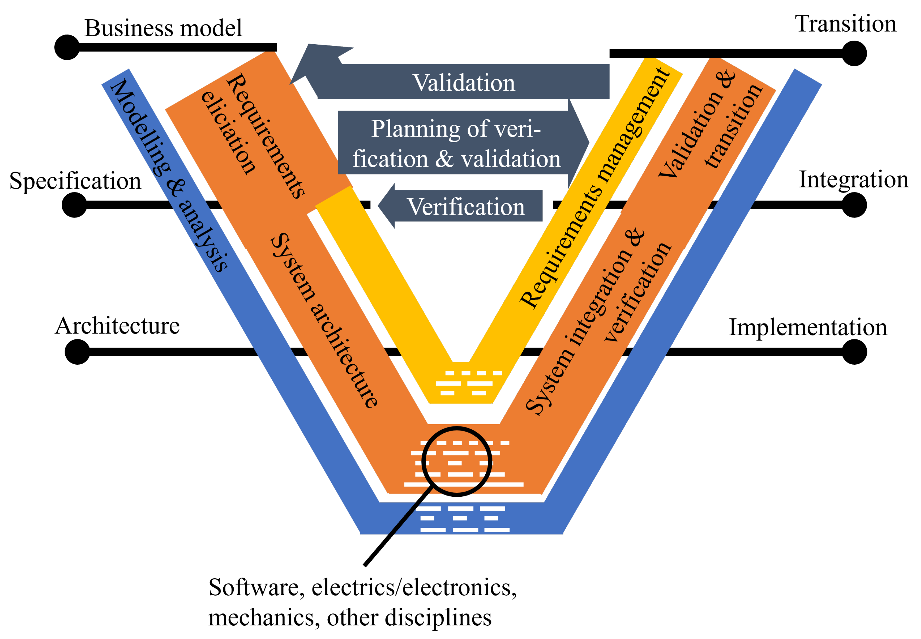
Software Development for Automation
Software plays a critical role in managing the sorting process.
It should include algorithms for item recognition and sorting logic.
User interfaces must be intuitive for operators to monitor and control the system.
Notes:
Image source: https://rockwellautomation.scene7.com

Slide 11
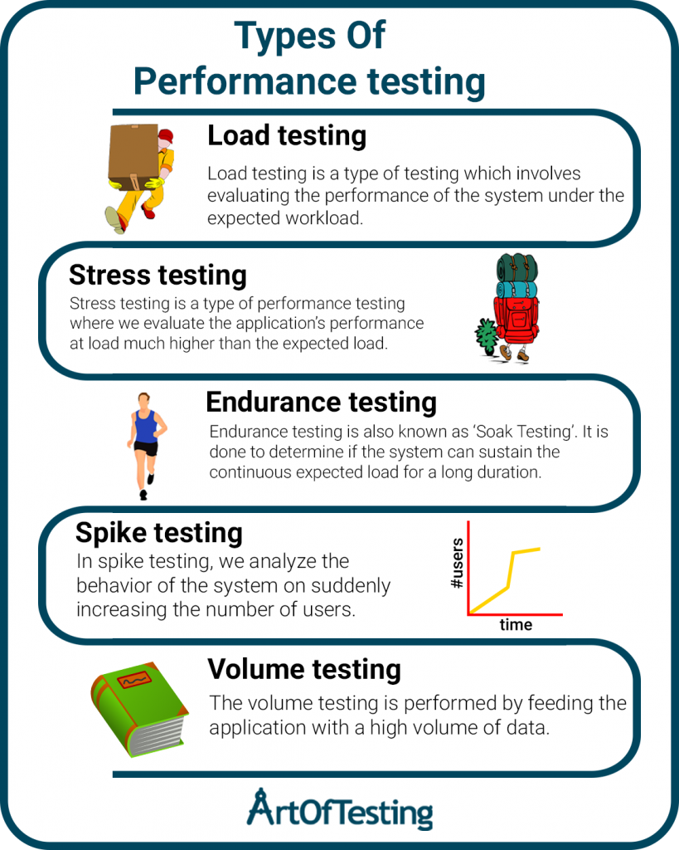
Prototyping and Testing
Developing a prototype is essential for evaluating the system's performance.
Testing involves checking sorting accuracy and speed under real-world conditions.
Iterative testing allows for adjustments and improvements to the system.
Notes:
Image source: https://artoftesting.com

Slide 12
Challenges and Solutions
Common challenges include sensor misalignment and software bugs.
Implementing redundancy can help mitigate risks related to component failures.
Continuous monitoring and maintenance are crucial for long-term operation.
Notes:
Image source: https://img.helpnetsecurity.com

Slide 13
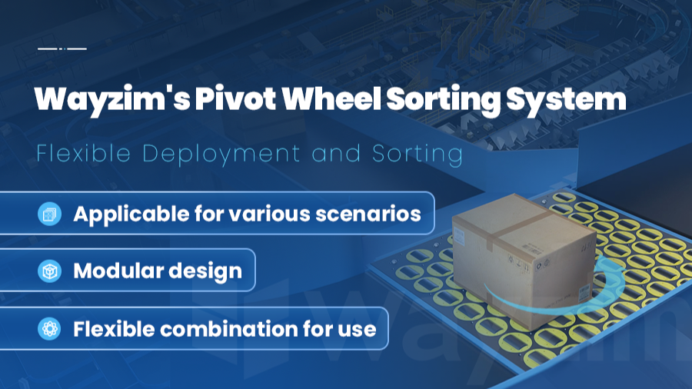
Case Study: Implementation in a Warehouse
A case study showcases the deployment of the automated sorting system in a warehouse.
The system resulted in a 30% increase in sorting efficiency.
Operator feedback highlighted improvements in workplace safety and ergonomics.
Notes:
Image source: https://www.smartlogitecx.com.au

Slide 14
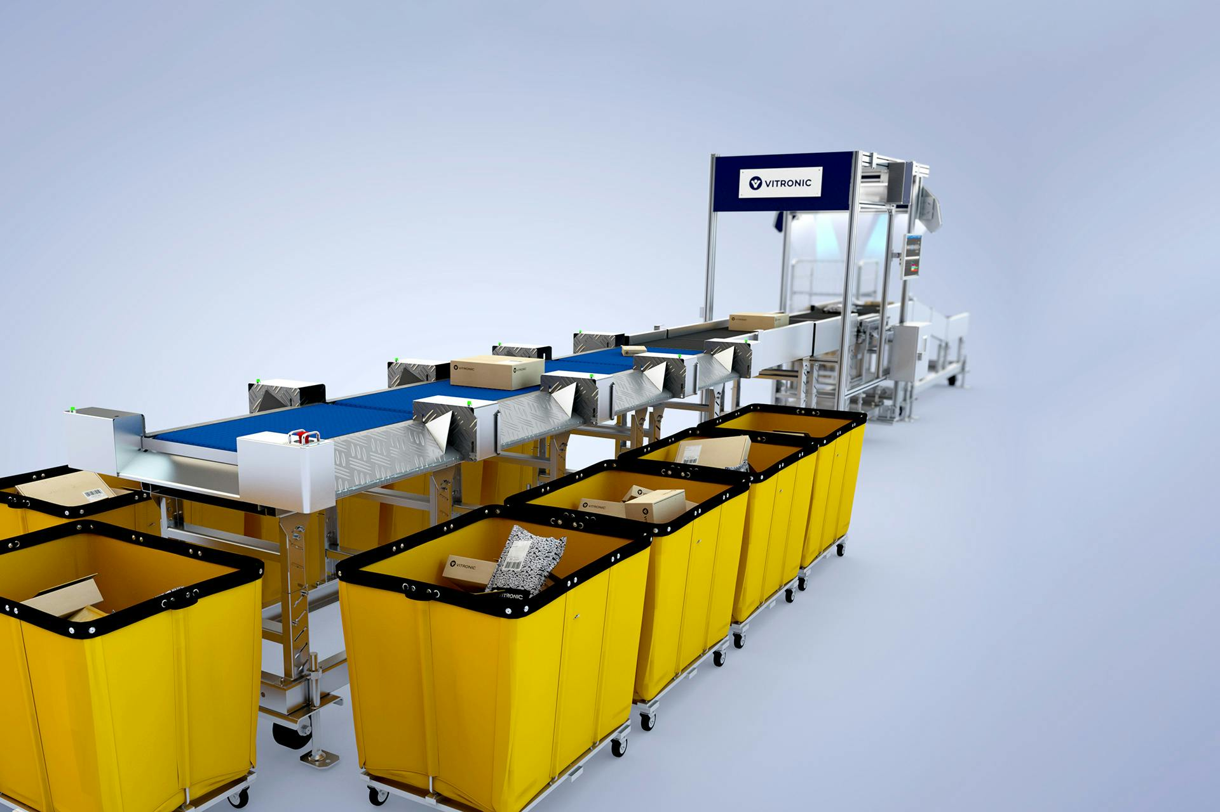
Future Enhancements
Future work could involve incorporating machine learning for better item recognition.
Enhancements may also include increased automation and integration with AI technologies.
Continuous upgrades will ensure the system adapts to evolving industry needs.
Notes:
Image source: https://elearningindustry.com

Slide 15

Results (Output)

Slide 16
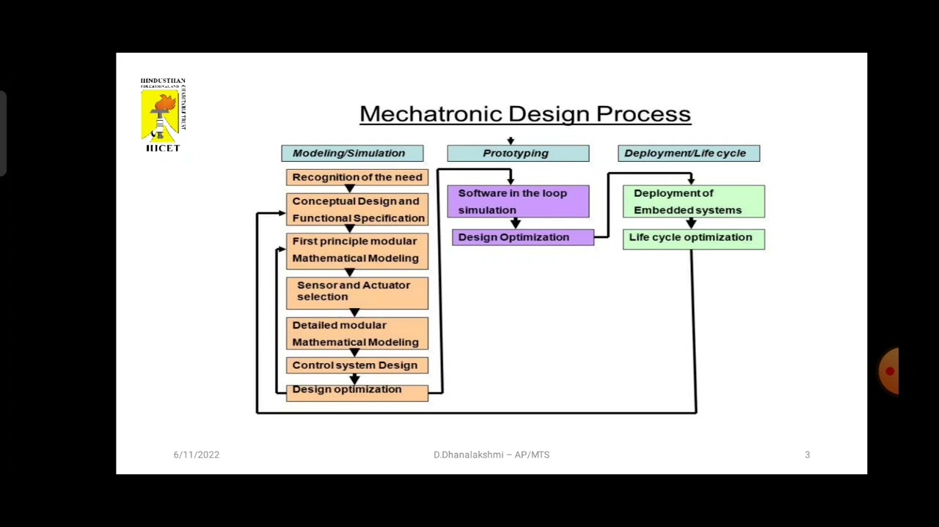
Conclusion
The automated sorting system exemplifies the practical application of mechatronics principles.
It demonstrates significant improvements in efficiency and accuracy over manual sorting.
The project paves the way for further innovations in automated systems.
Notes:
Image source: https://i.pinimg.com

Slide 17
References
Bolton, W. (2015). Mechatronics: Electronic Control Systems in Mechanical and Electrical Engineering (6th ed.). Pearson Education.
Groover, M. P. (2019). Automation, Production Systems, and Computer-Integrated Manufacturing (5th ed.). Pearson.
Mikell P. Groover & E. Zimmers (1984). CAD/CAM: Computer-Aided Design and Manufacturing. Prentice-Hall.
Ikechukwu, I. A., & Osakwe, S. O. (2017). Development of an Automated Bottle Sorting System. International Journal of Engineering Research and Technology (IJERT), 6(10), 50–55.

Slide 18
THANK YOU

